Slide 1
Process Management
CS 3100: Operating Systems
Supplemental Material for Chapter 3
Richard Fry, PhD
Department of Computer Science
Weber State University

Slide 2
Process Concept
An operating system executes a variety of programs
    batch systems - jobs
    time-shared systems - user programs or tasks
    job and program used interchangeably
Process = program in execution
    process execution proceeds in a sequential fashion
A process contains
    program counter, stack and data section

Slide 3
Process =? Program
main () {
…;
}
A() {
…
}
main () {
…;
}
A() {
…
}
Heap
PCB
Program
Process
Stack
A
main
More to a process than just a program:
  Program is just part of the process state
  I run Notepad on lectures.txt, you run it on homework.java – Same program, different processes
Less to a process than a program:
  A program can invoke more than one process

Slide 4
OS Requirements for Processes
OS must interleave the execution of several processes to maximize CPU usage while providing reasonable response time.
OS must allocate resources to processes while avoiding deadlock and starvation.
OS must support inter process communication (IPC) and user creation of processes.
We can characterize the behavior of an individual process by sequence of instructions that execute on the CPU (a trace).

Slide 5

Tracing a Process

Slide 6
When does a process get created?
Submission of a job by the user
User logging on
Created by OS when providing a service to a user (ex: printing a file)
Spawned by an existing process
  a user program can dictate the creation of a number of processes (or threads, covered in Chapter 4).

Slide 7
Reasons for Process Termination
Normal completion
Time limit exceeded
Memory unavailable
Memory bounds violation
Protection error
  example: write to read-only file
Arithmetic error
Time overrun
  process waited longer than a specified maximum for an event

Slide 8
Reasons for Process Termination
I/O failure
Invalid instruction
  happens when trying to execute data
Privileged (kernel) instruction
Operating system intervention
  such as when deadlock occurs
Parent requests to terminate one offspring
Parent terminates, so child processes terminate as well

Slide 9
Process Scheduling Queues
Basic 2 State Process Model: Running or Not Running
Job Queue - set of all processes in the system
Ready Queue - set of all processes residing in main memory, ready and waiting to execute.
Device Queues - set of processes waiting for an I/O device
Queue Structures are typically linked list, circular list etc.

Slide 10
Process Schedulers / Dispatchers
An OS service that assigns the CPU to one process or to another
Short Term Scheduler decides what process runs next on the CPU according to one or more a scheduling algorithms (Chapter 5)
Executes at least once every 100ms. Must decide fast!
Other schedulers:
    Long term scheduler - admits new jobs to keep load balanced between I/O and CPU bound processes
    Medium term scheduler – ensures the right mix by sometimes swapping out jobs to secondary storage (virtual memory) and resuming them later

Slide 11
Process States (5 State Model)
As a process executes, it changes state (context switch) – either running or not running.
The two states are not good enough, however, to actually define what “Not Running” means.
So, most OS’s use a basic 5 state model:
  new: The process is being created.
  running: Instructions are being executed.
  waiting (blocked): The process is waiting for some event to occur.
  ready: The process is waiting to be assigned to a process.
  terminated (exit): The process has finished execution.

Slide 12
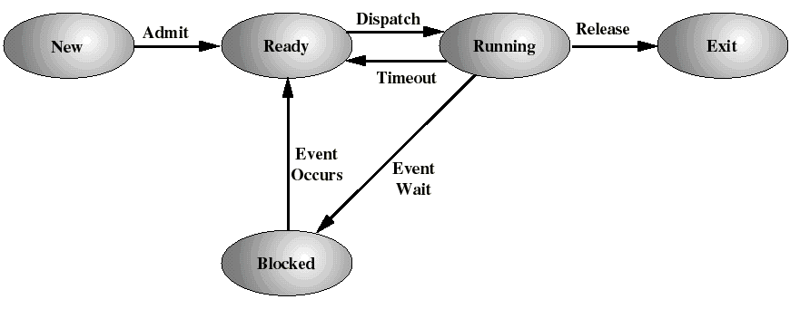
A Five-State Process Model

Slide 13
Process Transitions
New -> Admit:
  long-term scheduler decides that the process can be executed
Long Term Scheduler

Slide 14
Process Transitions
Short Term Scheduler
Ready --> Running
  The short term scheduler selects a new process to run
  (to be discussed Chapter 5).
Running --> Ready
  the running process is timed out
  the running process gets interrupted because a higher priority process is in the ready state (needs to run)

Slide 15
Process Transitions
Running --> Blocked/Waiting
  When a process requests
  something for which it must wait
    a service of the OS that requires a wait
    an access to a resource not yet available
    initiates I/O and must wait for the result
    waiting for a process to provide input (IPC)
Blocked/Waiting --> Ready
  When the event for which it was waiting occurs

Slide 16
Process State Diagram

Slide 17
The need for swapping
With the 5 State Model, all the processes had to be (at least partly) in main memory
Even with virtual memory, keeping too many processes in main memory will deteriorate the system’s performance
  ex: coexistence of several processes that do not use enough of the CPU (e.g. are all blocked)
The OS may need to suspend some processes to bring in others, i.e.: to swap them out to auxiliary memory (disk).
We add 2 new states, which extend the Blocked and Ready states:
  Blocked Suspend: blocked processes which have been swapped out to disk
  Ready Suspend: ready processes which have been swapped out to disk

Slide 18
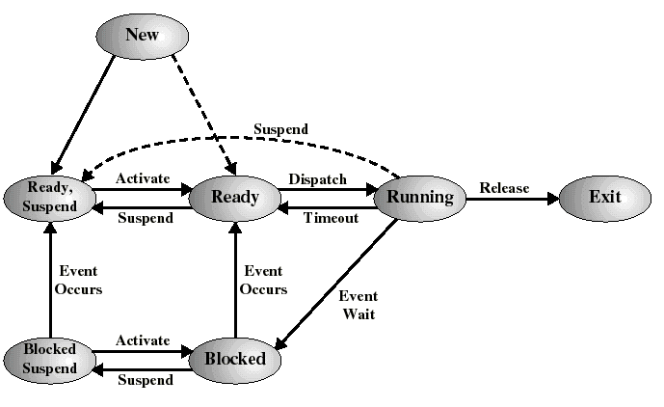
A Seven-state Process Model
Medium Term Scheduler

Slide 19
New state transitions
(medium-term scheduling)
Blocked --> Blocked Suspend
  When all processes are blocked, the OS may remove a blocked process to bring a ready process in memory
Blocked Suspend --> Ready Suspend
  When the event for which process has been waiting occurs
Ready Suspend --> Ready
  When no ready processes in main memory
  Normally, this transition is paired with Blocked --> Blocked suspend for another process (memory space must be found)
Ready--> Ready Suspend
  When there are no blocked processes and must free memory for adequate performance

Slide 20
Operating System Control Structures
An OS maintains the following tables for managing processes and resources:
  Memory occupation tables (upcoming lecture)
  I/O tables (upcoming lecture)
  File tables (upcoming lecture)
  Process tables (these slides)

Slide 21
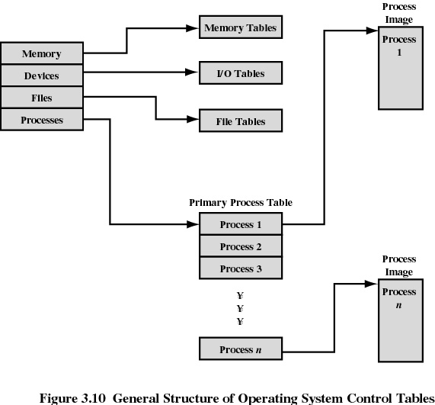

Slide 22
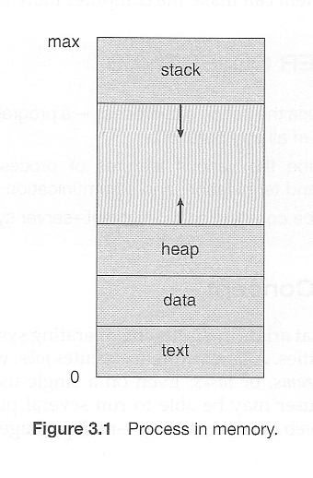
A process in memory
  The text section comprises the compiled program code, read in from non-volatile storage when the program is launched.
  The data section stores global and static variables, allocated and initialized prior to executing main.
  The heap is used for dynamic memory allocation, and is managed via calls to new, delete, etc.
  The stack is used for local variables. Space on the stack is reserved for local variables when they are declared ( at function entrance or elsewhere, depending on the language ), and the space is freed up when the variables go out of scope. Note that the stack is also used for function return values, and the exact mechanisms of stack management may be language specific.
  Note that the stack and the heap start at opposite ends of the process's free space and grow towards each other. If they should ever meet, then either a stack overflow error will occur, or else a call to create a new process will fail due to insufficient memory available.
When processes are swapped out of memory and later restored, additional information must also be stored and restored. Key among them are the program counter and the value of all program registers.

Slide 23

Process Control Block
(represented by Operating System)
Contains information associated with each process
  Process State - e.g. new, ready, running etc.
  Process Number – Process ID
  Program Counter - address of next instruction to be executed
  CPU registers - general purpose registers, stack pointer etc. (computer architecture specific)
  CPU scheduling information - process priority, pointer
  Memory Management information - base/limit information
    I/O Status information - list of I/O devices allocated
    Thread information (if applicable)
Process
Control
Block

Slide 24
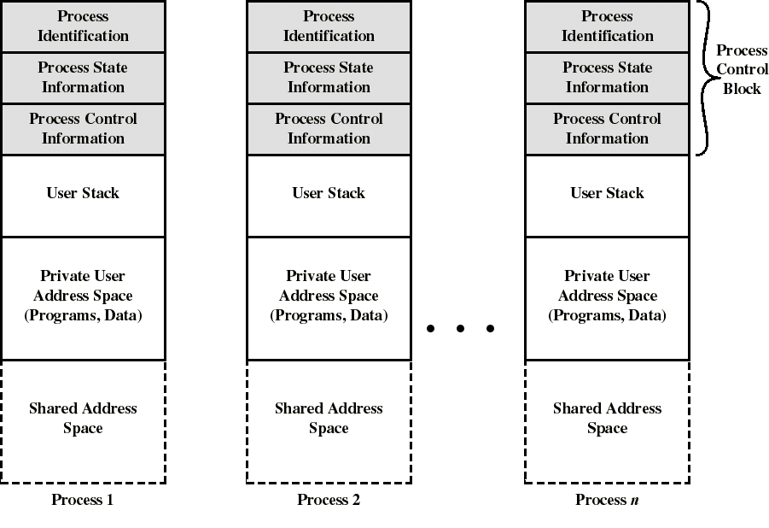
Process images

Slide 25
What process information needs to be saved and when?
Mode switching: process is suspended (e.g. a process interrupt) but immediately after this it resumes execution on the same CPU:
  only information necessary to resume execution of the same process needs to be saved (e.g. program counter)
Process switching: process is suspended but another process will take the CPU next:
  more may need to be saved: context, data...
  also process state must be updated.

Slide 26
When to Switch a Process ?
A process switch may occur whenever the OS has gained control of CPU. i.e. when:
  Supervisor Call
    explicit request by the program (ex: I/O). The process will probably be blocked
  Trap
    An error resulted from the last instruction. It may cause the process to be moved to exit state
  Interrupt
    the cause is external to the execution of the current instruction. Control is transferred to Interrupt Handler

Slide 27
Examples of interruptions
Timers
  process has used up its time - transfers to ready state
I/O completion
  transfer process to ready state
  CPU scheduler will decide when to resume it
Memory fault, page fault
  In virtual memory systems, process requests a page that is not in memory
  block process, read page in memory

Slide 28
Execution of the Operating System
Up to now, by process we were referring to “user process”
If the OS is just like any other collection of programs, is the OS a process?
If so, how it is controlled?
The answer depends on the OS design.

Slide 29
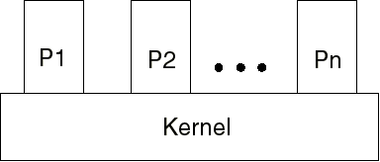
Nonprocess Kernel (old)
The concept of process applied only to user programs
OS code was executed as a separate entity in privilege mode
OS code never got executed within a process

Slide 30
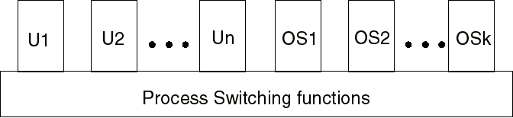
Process-based Operating System
The OS is a collection of system processes, outside of user’s address space
Major kernel functions are separate processes
Process switching functions are executed outside of any process

Slide 31
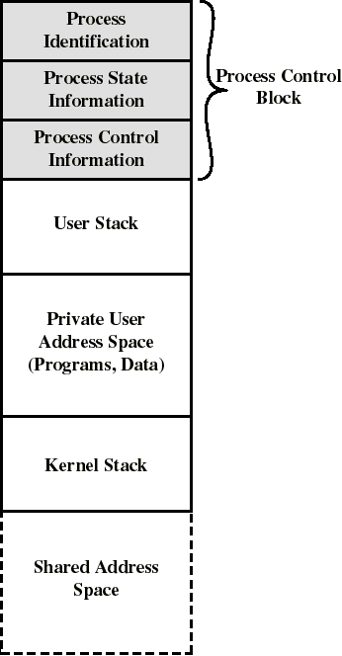
Execution within User Processes
OS code and data are in the shared address space and are shared by all user processes
Separate kernel stack for calls/returns when the process is in kernel mode
On Interrupts, Traps, System calls: CPU switches to kernel mode to execute OS routine within the context of user process (mode switch)
Control passes to process switching functions (outside processes) only when needed (e.g.: interprocess synchronization, process scheduling…)

Slide 32
Interprocess Communication (IPC)
Proc 1
Proc 2
Proc 3
Separate address space isolates processes
  High Creation/Memory Overhead; (Relatively) High Context-Switch Overhead
Mechanism for processes to communicate and synchronize actions.
      Via shared memory - Accomplished by mapping addresses to common DRAM
        Read and Write through memory
      Via Messaging system - processes communicate without resorting to shared variables.
        send() and receive() messages
        Can be used over the network!
      Messaging system and shared memory not mutually exclusive
        can be used simultaneously within a single OS or a single process.
Notes:
Collaboration allows faults to propagate…

Slide 33
Shared Memory Communication
Data 2
Code
Data
Heap
Stack
Shared
Code
Data
Heap
Stack
Shared
Stack 1
Heap 1
Code 1
Stack 2
Data 1
Process 1
Virtual
Address
Space 1
Process 2
Virtual
Address
Space 2
Heap 2
Code 2
Shared
Communication occurs by “simply” reading/writing to shared address space
  Really low overhead communication
  Introduces complex synchronization problems (Chapter 5)

Slide 34
Cooperating Processes via Message Passing
IPC facility provides two operations.
        send(message) - message size can be fixed or variable
        receive(message)
If processes P and Q wish to communicate, they need to:
      establish a communication link between themselves
      exchange messages via send/receive
This is accomplished 1 of 2 ways
  Direct or Indirect (using Mailbox or Port) communications with Buffering and Queues.
  Synchronous or asynchronous communication (blocking / not blocking). Common in a lot of OS I/O algorithms.

Slide 35
Important concepts for exam
(and next week’s quiz)
3.1 Process Concepts (2, 5, and 7 State Process Model, PCB, Process Image)
3.2 Process Scheduling (Queues - Types, Schedulers – Short, Medium, Long)
3.3 Operations in Processes (Ways to Create / Terminate)
3.4 and 3.6 Inter-Process Communication (Message Passing – send() and receive(), direct/indirect, synchronous /asynchronous)

